Slide 1
Clustering -Part I
Data Analytics - WQD 7003

Slide 2
Outline
What is Cluster Analysis?
Measuring data similarity
A Categorization of Major Clustering Methods
K-Means Clustering
K-Medoids Clustering
Summary

Slide 3
Outline
What is Cluster Analysis?
Measuring data similarity
A Categorization of Major Clustering Methods
K-Means Clustering
K-Medoids Clustering
Summary

Slide 4
What is Cluster Analysis?
Finding groups of objects such that the objects in a group will be similar (or related) to one another and different from (or unrelated to) the objects in other groups
Clustering is unsupervised learning in that there are no class labels for the training instances
Inter-cluster distances are maximized
Intra-cluster distances are minimized

Slide 5
What is Cluster Analysis?
Cluster: a collection of data objects
Similar to one another within the same cluster
Dissimilar to the objects in other clusters
Cluster analysis
Grouping a set of data objects into clusters
Clustering is unsupervised classification
no predefined classes/dependent variable
Common uses:
Determine if meaningful relationships in the form of concepts can be found in the data
Evaluate the likely performance of a supervised learner model
Determine a best set of input attributes for supervised learning
Detect outliers

Slide 6
General Applications of Clustering
Pattern Recognition
Spatial Data Analysis
create thematic maps in GIS by clustering feature spaces
detect spatial clusters and explain them in spatial data mining
Image Processing
Economic Science (especially market research)
WWW
Document classification
Cluster Weblog data to discover groups of similar access patterns

Slide 7
Examples of Clustering Applications
Marketing: Help marketers discover distinct groups in their customer bases, and then use this knowledge to develop targeted marketing programs
Land use: Identification of areas of similar land use in an earth observation database
Insurance: Identifying groups of motor insurance policy holders with a high average claim cost
City-planning: Identifying groups of houses according to their house type, value, and geographical location
Earth-quake studies: Observed earth quake epicenters should be clustered along continent faults

Slide 8
What is not Cluster Analysis?
Supervised classification
Have class label information
Simple segmentation
Dividing students into different registration groups alphabetically, by last name
Results of a query
Groupings are a result of an external specification

Slide 9
What Is Good Clustering?
A good clustering method will produce high quality clusters
high intra-class similarity: cohesive within clusters
low inter-class similarity: distinctive between clusters
The quality of a clustering result depends on both the similarity measure used by the method and its implementation.
The quality of a clustering method is also measured by its ability to discover some or all of the hidden patterns.

Slide 10
Notion of a Cluster can be Ambiguous
How many clusters?
Six Clusters
Two Clusters
Four Clusters

Slide 11
Outline
What is Cluster Analysis?
Measuring data similarity
A Categorization of Major Clustering Methods
K-Means Clustering
K-Medoids Clustering
Summary

Slide 12
Similarity and Dissimilarity
Similarity
Numerical measure of how alike two data objects are
Value is higher when objects are more alike
Often falls in the range [0,1]
Dissimilarity (i.e., distance)
Numerical measure of how different are two data objects
Lower when objects are more alike
Minimum dissimilarity is often 0
Upper limit varies
Proximity refers to a similarity or dissimilarity

Slide 13
Example: Data Matrix and Distance Matrix
Data Matrix
Distance Matrix (i.e., Dissimilarity Matrix) for Euclidean Distance

Slide 14
Similarity and Dissimilarity Between Objects
Distances are normally used to measure the similarity or dissimilarity between two data objects
Some popular ones include:
Minkowski distance
Manhattan distance
Euclidean distance

Slide 15
Minkowski Distance
Minkowski distance: A popular distance measure
where i = (x_{i1}, x_{i2}, …, x_{ip}) and j = (x_{j1}, x_{j2}, …, x_{jp}) are two p-dimensional data objects, and q is the order
Properties
d(i, j) > 0 if i ≠ j, and d(i, i) = 0 (Positive definiteness)
d(i, j) = d(j, i) (Symmetry)
d(i, j) ≤ d(i, k) + d(k, j) (Triangle Inequality)
A distance that satisfies these properties is a metric

Slide 16
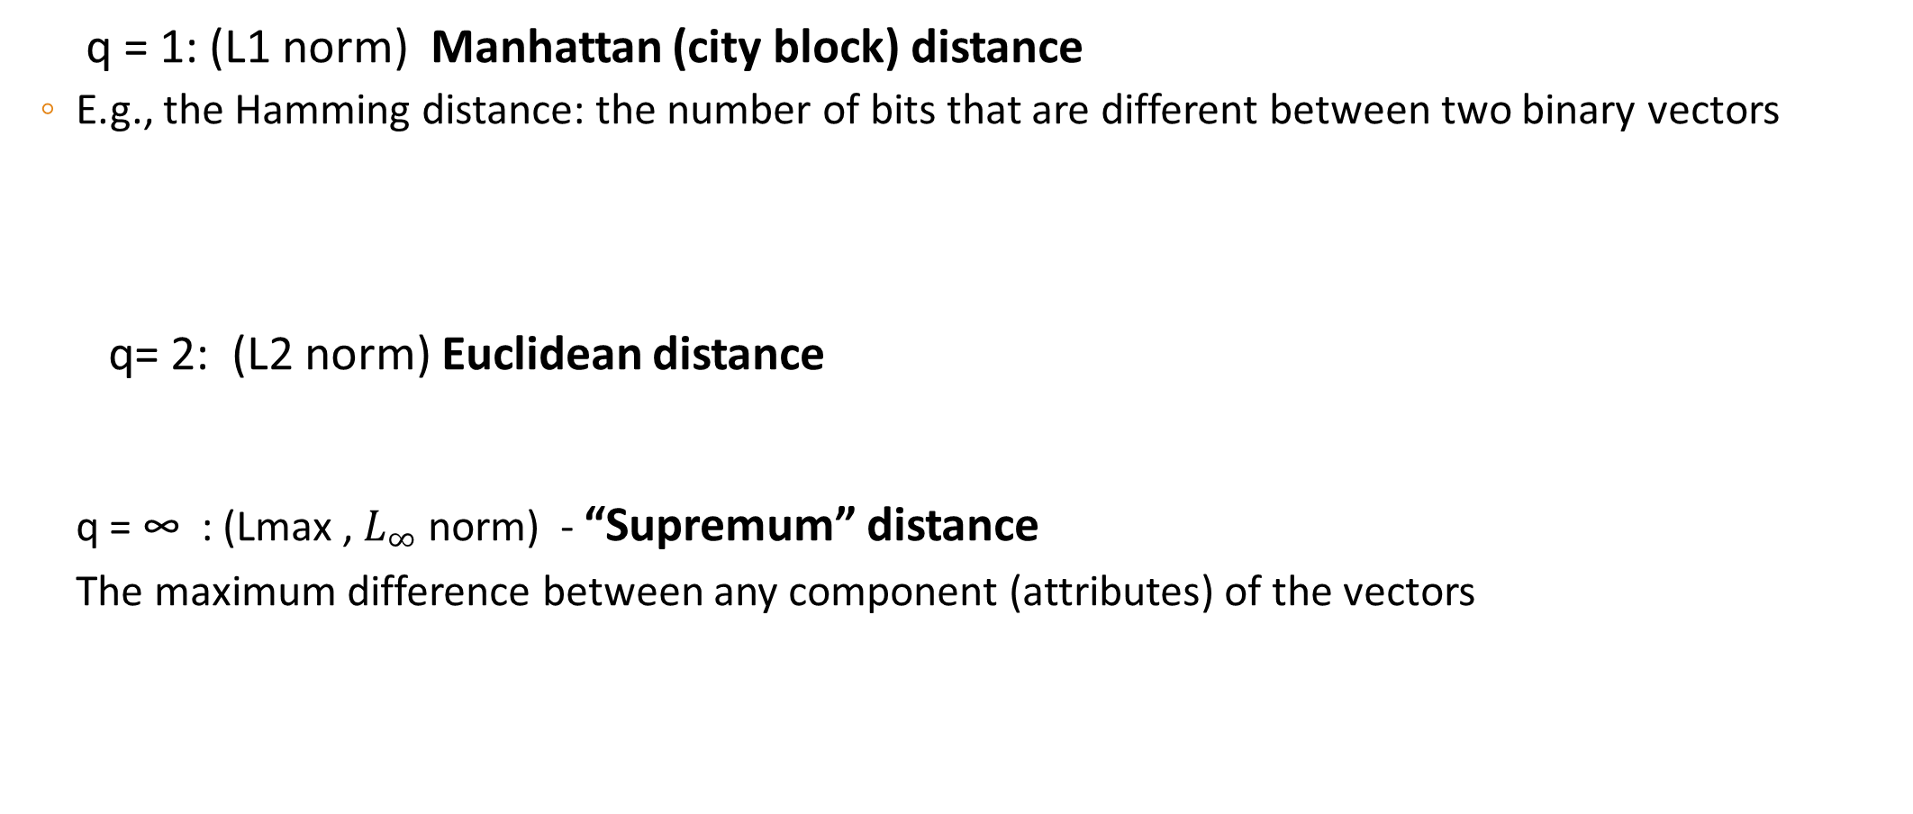
Special Cases of Minkowski Distance
q = 1: (L1 norm) Manhattan (city block) distance
E.g., the Hamming distance: the number of bits that are different between two binary vectors
q= 2: (L2 norm) Euclidean distance
q = ∞ : (Lmax , $L_{∞}$ norm) - “Supremum” distance
The maximum difference between any component (attributes) of the vectors

Slide 17
Example: Minkowski Distance
Distance Matrix

Slide 18
Outline
What is Cluster Analysis?
Measuring data similarity
A Categorization of Major Clustering Methods
K-Means Clustering
K-Medoids Clustering
Summary

Slide 19
Major Clustering Approaches
Partitioning algorithms: Construct various partitions and then evaluate them by some criterion
K-Means Clustering
Nearest Neighbor Algorithm
PAM Algorithm
Expectation Maximization Algorithm (EM)
Hierarchy algorithms: Create a hierarchical decomposition of the set of data (or objects) using some criterion
Agglomerative Algorithms
Divisive Clustering
Model-based: A model is hypothesized for each of the clusters and the idea is to find the best fit of that model to each other
Conceptual Clustering
Clustering with Neural Networks
Clustering Large Databases
BIRCH
DBSCAN
CURE Algorithm

Slide 20
Properties of Clustering Algorithms
Clustering algorithms can have different properties:
Hierarchical or partitioning: hierarchical algorithms induce a hierarchy of clusters of decreasing generality, for partitioning algorithms, all clusters are the same.
Iterative: the algorithm starts with initial set of clusters and improves them by reassigning instances to clusters.
Hard and soft: hard clustering assigns each instance to exactly one cluster. Soft clustering assigns each instance a probability of belonging to a cluster.
Disjunctive: instances can be part of more than one cluster.

Slide 21
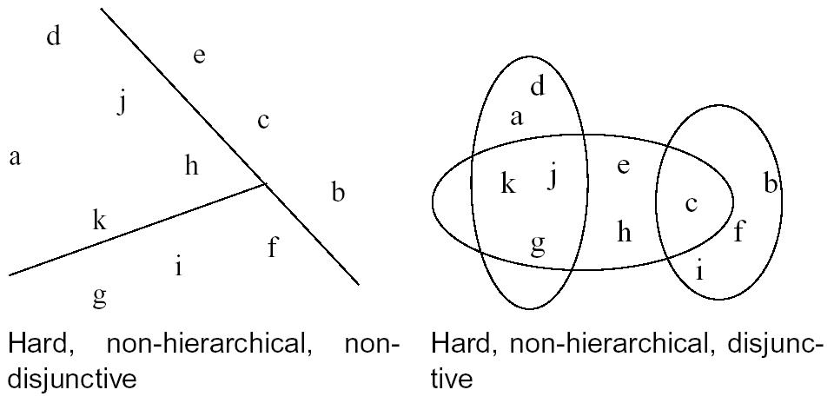
Examples

Slide 22
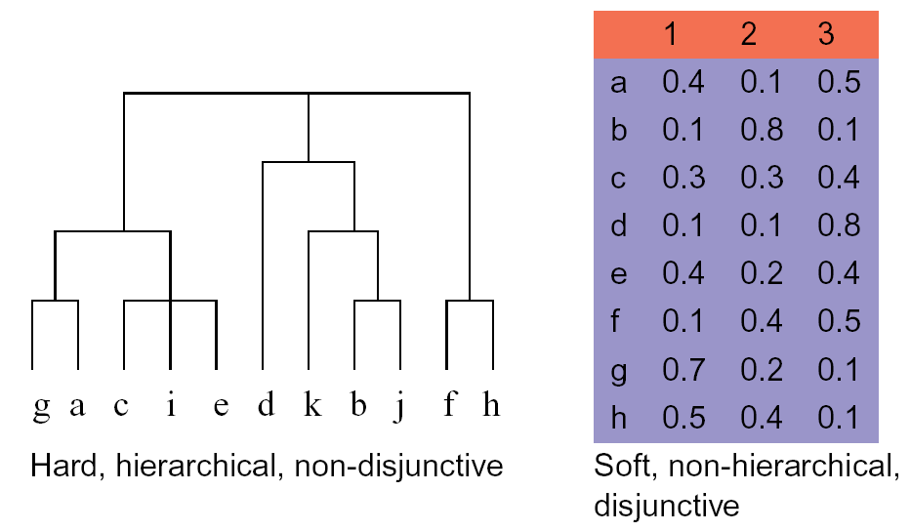
Examples

Slide 23
Outline
What is Cluster Analysis?
Measuring data similarity
A Categorization of Major Clustering Methods
K-Means Clustering
K-Medoids Clustering
Summary

Slide 24
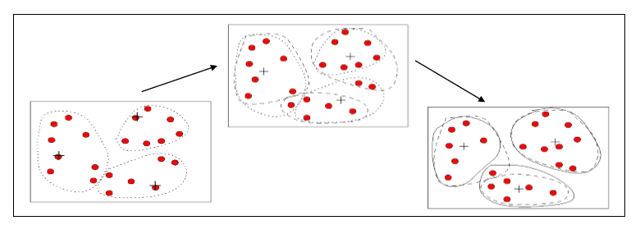
The k-Means Algorithm (1)
Iterative, hard, flat clustering algorithm based on Euclidian distance.
Intuitive formulation:
Choose a value for K, the total number of clusters.
Randomly choose K points as cluster centers.
Assign the remaining instances to their closest cluster center.
Calculate a new cluster center for each cluster.
Repeat steps 3-5 until the cluster centers do not change.

Slide 25
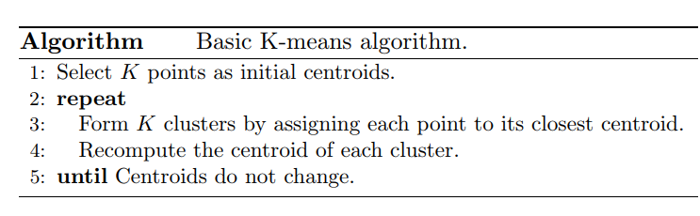
The k-Means Algorithm (2)

Slide 26
K-Means Clustering – How it Works
K=2
Arbitrarily partition objects into k groups
Update the cluster centroids
The initial data set
Loop if needed
Reassign objects
Partition objects into k nonempty subsets
Repeat
Compute centroid (i.e., mean point) for each partition
Assign each object to the cluster of its nearest centroid
Until no change
Update the cluster centroids

Slide 27
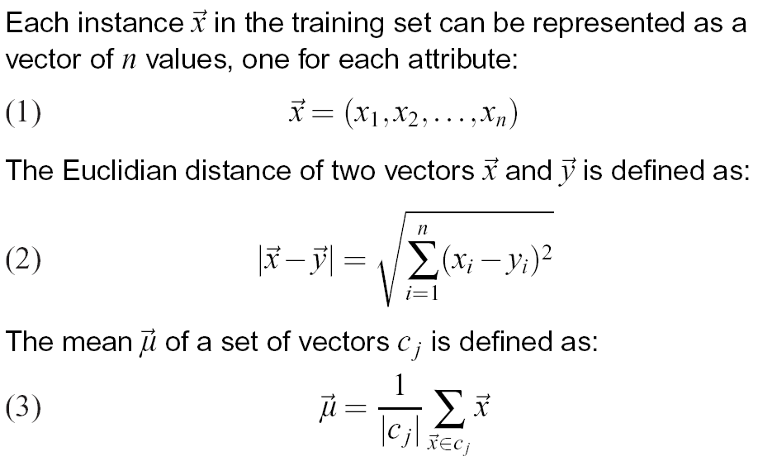
The k-Means Algorithm (2)

Slide 28
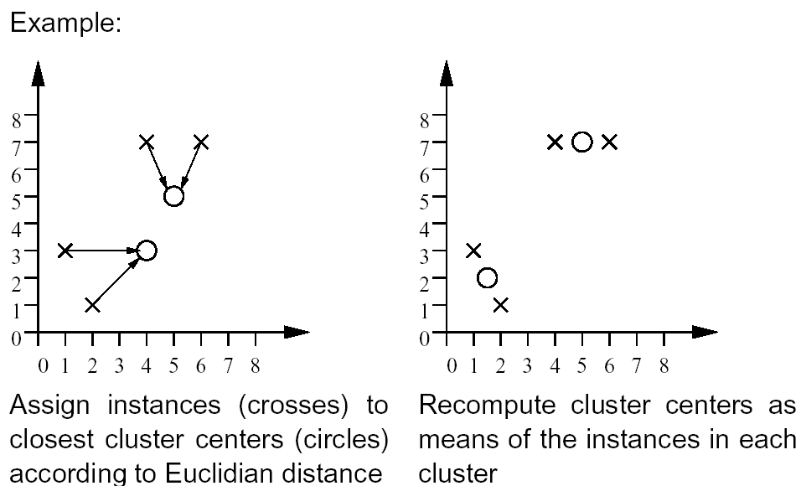
The k-Means Algorithm (3)

Slide 29
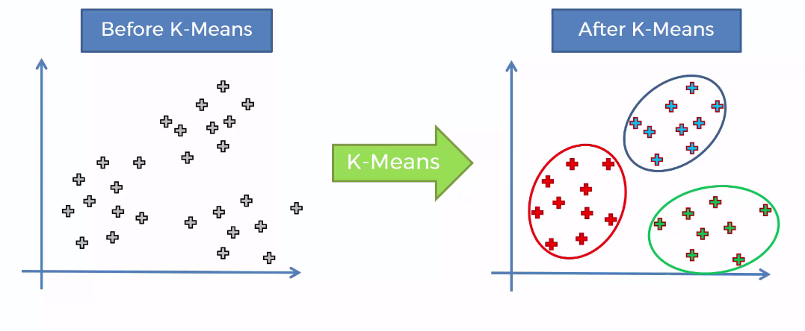
Example 1: k-Means Algorithm (1)

Slide 30
How did K-means works
Step 1- Choose the number of K of clusters
Step 2- Select at random K points, the centroids (not necessarily from your datasets)
Step 3- Assign each data point to the closest centroid – That forms K clusters
Step 4- Compute and place the new centroid of each cluster
Step 5- Reassign each data point to the new closets centroid. If any reassignment took place, go to Step 4. Otherwise to final.

Slide 31
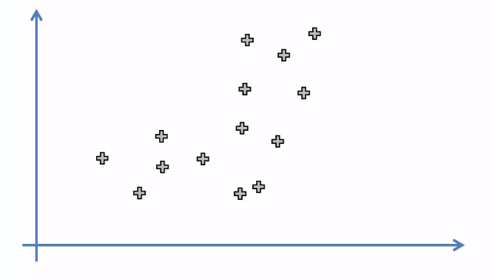
Example 1: k-Means Algorithm
Step 1: Choose the number of K of clusters : K= 2

Slide 32
Example 1: k-Means Algorithm
Step 2: Select at random K points, the centroids (not necessarily from your datasets)

Slide 33
Example 1: k-Means Algorithm
Step 3: Assign each data point to the closest centroid – That forms K clusters

Slide 34
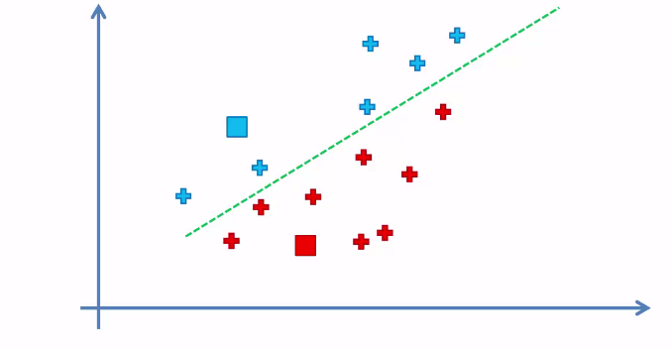
Example 1: k-Means Algorithm
Step 3: Assign each data point to the closest centroid – That forms K clusters

Slide 35
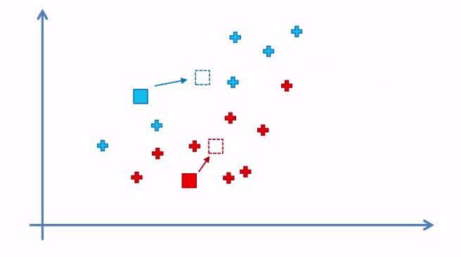
Example 1: k-Means Algorithm
Step 4: Compute and place the new centroid of each cluster

Slide 36
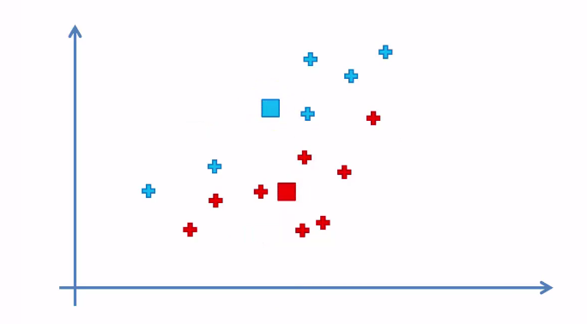
Example 1: k-Means Algorithm
Step 4: Compute and place the new centroid of each cluster

Slide 37
Example 1: k-Means Algorithm
Step 5- Reassign each data point to the new closets centroid. If any reassignment took place, go to Step 4. Otherwise to final.

Slide 38
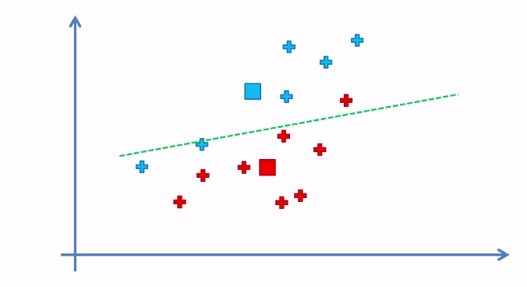
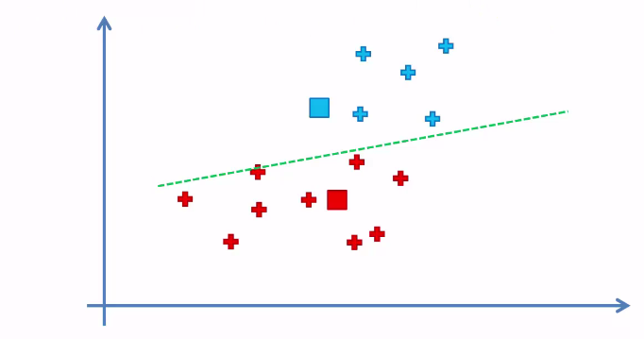
Example 1: k-Means Algorithm
Step 5- Reassign each data point to the new closets centroid. If any reassignment took place, go to Step 4. Otherwise to final.

Slide 39
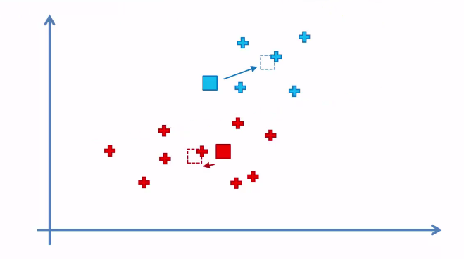
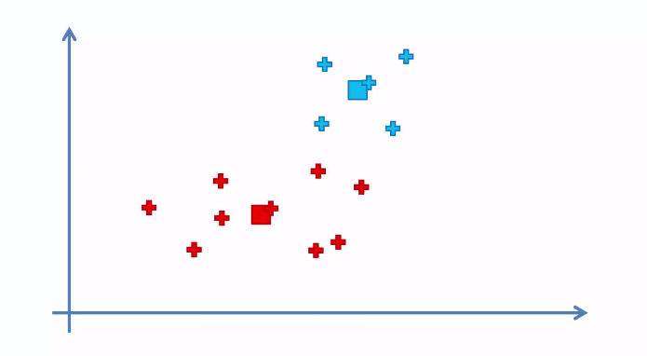
Example 1: k-Means Algorithm

Slide 40
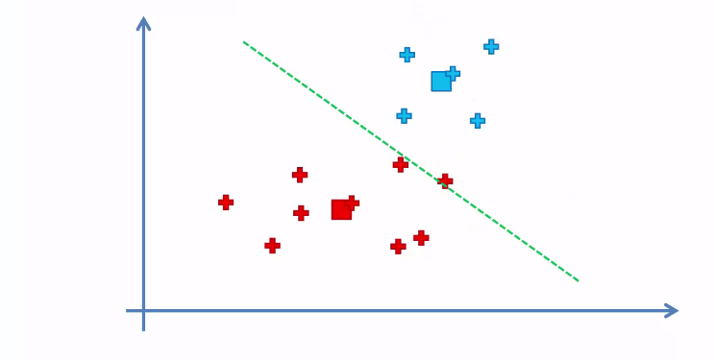
Example 1: k-Means Algorithm
Step 5- Reassign each data point to the new closets centroid. If any reassignment took place, go to Step 4. Otherwise to final.

Slide 41
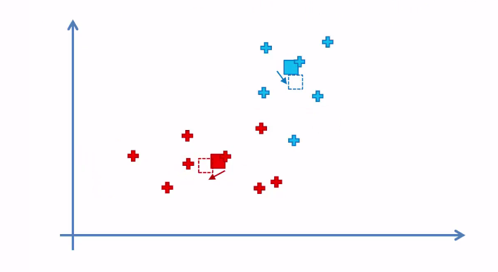
Example 1: k-Means Algorithm
Step 5- Reassign each data point to the new closets centroid. If any reassignment took place, go to Step 4. Otherwise to final.

Slide 42
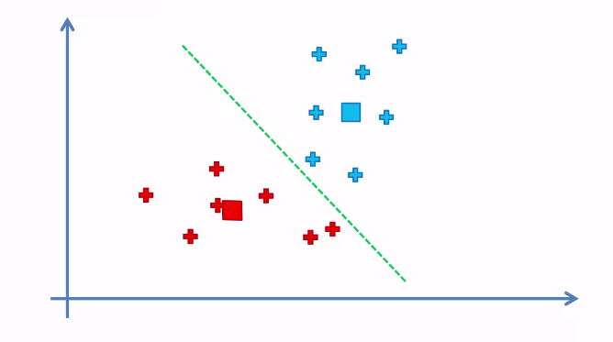
Example 1: k-Means Algorithm
Step 5- Reassign each data point to the new closets centroid. If any reassignment took place, go to Step 4. Otherwise to final.

Slide 43
Variations of the K-Means Method
A few variants of the k-means which differ in
Selection of the initial k means
Dissimilarity calculations
Strategies to calculate cluster means
Handling categorical data: k-modes
Replacing means of clusters with modes
Using new dissimilarity measures to deal with categorical objects
Using a frequency-based method to update modes of clusters
A mixture of categorical and numerical data: k-prototype method

Slide 44
Outline
What is Cluster Analysis?
Measuring data similarity
A Categorization of Major Clustering Methods
K-Means Clustering
K-Mediods Clustering
Summary

Slide 45
PAM(Partitioning Around Medoids): A Typical K-Medoids Algorithm
Total Cost = 20
10
9
8
Arbitrary choose k object as initial medoids
Assign each remaining object to nearest medoids
7
6
5
4
3
2
1
0
0
1
2
3
4
5
6
7
8
9
10
K=2
Randomly select a nonmedoid object,O_{ramdom}
Total Cost = 26
Do loop
Until no change
10
Compute total cost of swapping
10
Swapping O and O_{ramdom}
If quality is improved.
9
9
8
8
7
7
6
6
5
5
4
4
3
3
2
2
1
1
0
0
1
2
3
4
5
6
7
8
9
10
0
0
1
2
3
4
5
6
7
8
9
10
Notes:
45

Slide 46
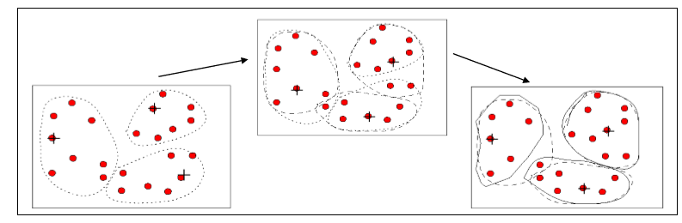
K-medoids
PAM(Partitioning Around Medoids): A Typical K-Medoids Algorithm
Each cluster is represented by one of the objects near the center of the cluster
Step1: randomly select k objects as the medoids of the clusters
Step2: for each remaining object, assign it to the cluster whose medoid is the nearest to the object
Step3: if the quality of the clustering (or cost of swapping can be minimized) can be improved by swapping a non-medoid with a medoid, swapping them and then go to Step 2; otherwise exit

Slide 47
K-medoids vs. K-means
Advantages
K-Medoids method is more robust than k-Means in the presence of noise and outliers
Disadvantages
K-Medoids is more costly that the k-Means method
Like k-means, k-medoids requires the user to specify k
It does not scale well for large data sets

Slide 48
Reference
Han, J., Pei, J., & Kamber, M. (2011). Data mining: concepts and techniques.
Peter Bruce , and Andrew Bruce (2017) Practical Statistics for Data Scientists
R for Data Science. Book by Garrett Grolemund and Hadley Wickham
Other Resources:
https://www.youtube.com/watch?v=EmxxOyLcYrw

Slide 49
Thank you

